Slide 1

Frequency Domain Analysis of Fine and Inexpensive Instruments
Moosa Azfar

Slide 2
Signal Processing Overview
What is signal processing?
What are its applications?
To discuss signal processing, we must define a “signal”
  A signal is a function that varies over space and time
It makes sense to discuss music in the context of signal processing because of this definition

Slide 3
Signal Processing Overview
Signals can contain information in both the “time domain” and “frequency domain”
The time domain represents how the signal changes as time progress
The frequency domain represents what frequencies the signal is comprised of
In the context of music, both concepts work in tandem

Slide 4
Signal Processing Overview
The focus of this project is on frequency domain analysis of violins
In the real world, signals are recorded in the time domain, represented as a series of amplitudes that fluctuate as time progresses
One of the aspects of signal processing focuses on turning this time domain data into frequency domain data
One method to transform time domain data into frequency domain data is the Fourier Transform

Slide 5
Signal Processing Overview
The Fourier Transform is a function that takes in time domain data as an input and returns frequency content of the signal.
There are many variants of the Fourier Transform but all work off the same basic principle.
Continuous signals must be sampled to use the Fourier Transform algorithm

Slide 6
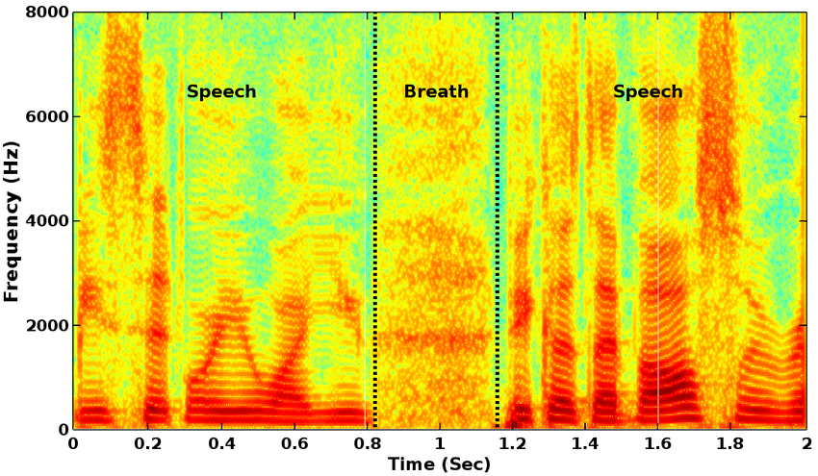
Fourier Transform

Slide 7
Review of Literature
Study of literature for this project started broadly
Work conducted by Therrick-Ari Anderson at Lincoln University studied musical instrument identification by using neural networks [1]
The data processing included the use of Fourier Transforms
This was a good start, as it showed justification to use FTs

Slide 8
Review of Literature
A more recent and relevant study conducted at the Department of Computer Science and Engineering at National Cheng-Kung University explored quantitative evaluation of violin performance by means of signal processing [2]
This study solely used Fourier Transforms to study how pitch variation and characteristics of vibrato affect a violinist’s performance
This was enough justification to proceed with the Fourier Transform as the algorithm for this project

Slide 9
Data Collection and Processing
Four instruments were acquired and recorded (n=4).
This is not ideal, as a much larger sample size would be needed to make any solid judgements
Sample size for this study is limited by practicality and availability of material
General claims about the data and its trends can still be made

Slide 10
Data Collection and Processing
For each instrument, the open strings were recorded both plucked and bowed
Three octave G major scale was recorded both plucked and bowed for all instruments
Open string harmonics were also recorded as these should contain high frequency information

Slide 11
Data Collection and Processing
The main goal in the data processing was to find harmonics and their intensities
  Harmonics are frequencies that are integer multiples of the fundamental frequency
  For A4, the fundamental frequency is 440 Hz, making the first harmonic 880 Hz.
The Fourier Transform algorithm returns the entire frequency spectrum, not just the harmonics

Slide 12
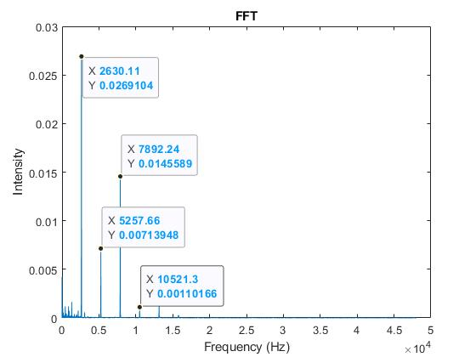
Results

Slide 13
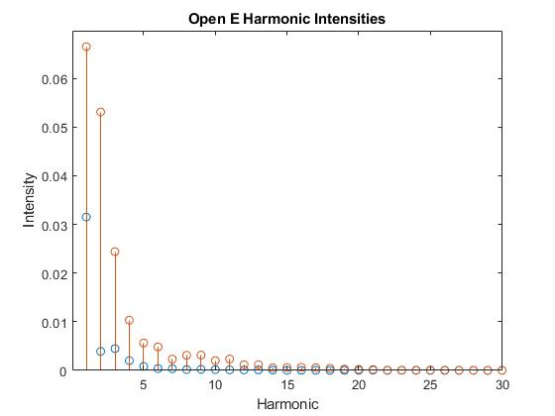
Results

Slide 14
Results
Harmonic intensities were extracted from the initial outputs to filter irrelevant information.
Instruments were compared across and among price ranges to determine if any general trends or patterns could be observed.
In final comparison, it was found that the open G string and open E string harmonics of a violin were a good tell of the quality of the instrument.
More data would be needed make any more specific and conclusive statements.

Slide 15
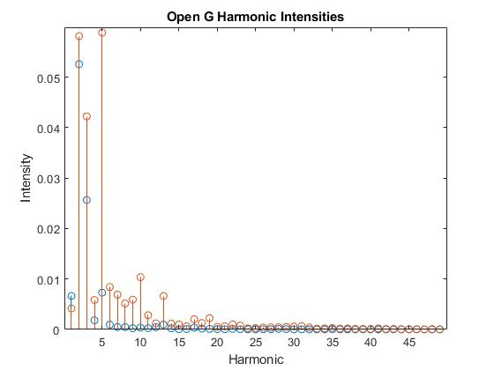
Results

Slide 16
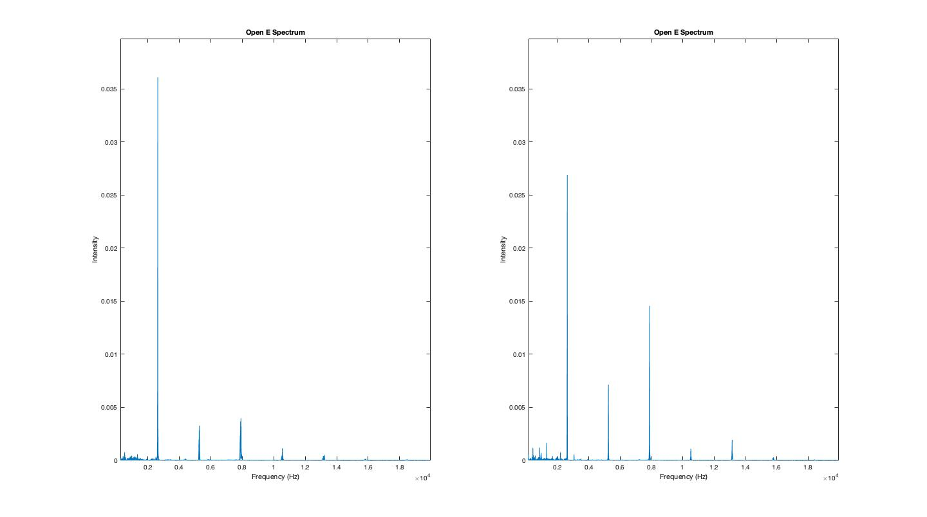
Results

Slide 17
References
T. -A. Anderson, "Musical instrument classification utilizing a neural network," 2017 12th International Conference on Computer Science and Education (ICCSE), 2017, pp. 163-166, doi: 10.1109/ICCSE.2017.8085482.
Y. Lin, W. -C. Chang and A. W. Y. Su, "Quantitative evaluation of violin solo performance," 2013 Asia-Pacific Signal and Information Processing Association Annual Summit and Conference, 2013, pp. 1-6, doi: 10.1109/APSIPA.2013.6694296.

Slide 18
QUESTIONS?

